Slide 1
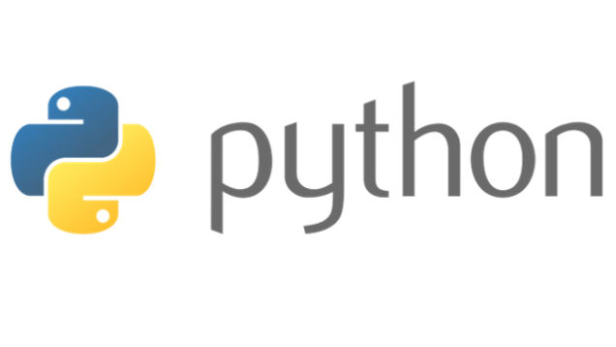
Variables, Keywords, Expressions, Statements

Slide 2
Program
Sequence of instructions that specify how to perform a computation.
Basic instructions in almost every program:
Input: Get data from keyboard, or file or some other device.
Output: Display data on the screen or send data to a file or other device.
Math: Perform basic mathematical operations like addition and multiplication.
Conditional Execution: Check for certain conditions and execute the appropriate sequence of statements.
Repetition: Perform some action repeatedly , usually with some variation

Slide 3
Debugging
Programming errors are called bugs.
Process of tracking bugs and correct them is called debugging.
Types of Errors
Syntax Errors : invalid code the compiler doesn't understand
  printf(%d,s)
Run Time Errors (Exceptions)
a= 10/0;
Semantic Errors : valid code the compiler understands
Dangling Else

Slide 4
Dangling Else
if (relative)
if (my friend)
cout << “both”;
else
cout << “neither”;
if (relative)
{
if (my friend)
cout << “both”;
}
else
cout << “neither”;

Slide 5
Formal and Natural Languages
Natural Languages are the languages that people speak, such as English, Spanish, French. They were not designed by people; they evolved naturally.
Formal Languages are languages that are designed by people for specific applications.
Programming languages are formal languages that have been designed to express computations.
Parsing is a process to figure out what the structure of the sentence is.
Notes:
So ,Guys how many of you are afraid of programming ???? , who think that coding is the most difficult thing to do ??? Pick one of them and ask him/her the recipe of Maggi or tea …

Slide 6
Difference between Natural and Formal Languages
Ambiguity: Natural languages are full of ambiguity.
Formal languages are designed to be nearly or completely unambiguous.
Redundancy: Natural languages are more redundant as compared to formal languages.
Literalness: Natural languages are full of idiom and metaphor. If I say, “The other shoe fell," there is probably no shoe and nothing falling. Formal languages mean exactly what they say.

Slide 7
Quiz
X=4
Y=5
print(“Addition = “,X*Y)
What type of error it is
Logical
Syntactical
Run time
All of these

Slide 8
Variable Expressions and Statements
Value is a one of the fundamental thing, that a program manipulates.
Variable is a name that refers to a value that maybe changed in the program.
The assignment statement creates new variables and gives them values:
>>> message = "What's up, Doc?"
>>> n = 17
>>> pi = 3.1415

Slide 9
Variable
Variable names must be meaningful.
It contains both numbers and letters, but they have to begin with a letter.
Case sensitive.
The underscore (_) character can appear in a name.
Eg.
  >>>76trombones = "big parade“ >>> more$ = 1000000
  SyntaxError: invalid syntax SyntaxError: invalid syntax
  >>> class = "Computer Science 101“
  SyntaxError: invalid syntax

Slide 10
BASIS FOR COMPARISON | IDENTIFIER | VARIABLE
Use | Identifier is used to name a variable, function, class, structure, union etc. | Variable is used to name a memory location, which holds a value.
Purpose | Created to give a unique name to an entity. | Allots a unique name to a particular memory location.
Range | All identifiers are not variable. | All variables names are identifier.
Example | int a; or int a(){ // } | int a; or float a; //

Slide 11
Keywords
They are reserved word for the internal processing by language.
Keywords define the language’s rules and structure and they can’t be used as variable names.
As of Python 3, there are thirty-three keywords in Python.

Slide 12
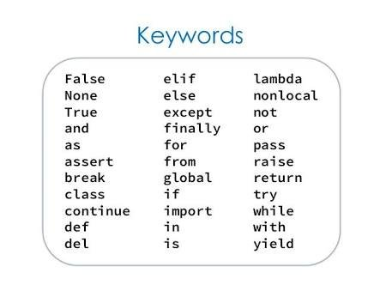

Slide 13
[myname is a valid variable name
True
False

Slide 14
Python in its language defines an inbuilt module “keyword” which handles certain operations related to keywords. A function “iskeyword()” checks if a string is keyword or not. Returns true if a string is keyword, else returns false.
>>> import keyword
>>> keyword.iskeyword("true")
False

Slide 15
Statements
A statement is an instruction that the Python interpreter can execute.
When you type a statement on the command line, Python executes it and displays the result, if there is one.
A script usually contains a sequence of statements. If there is more than one statement, the results appear one at a time as the statements execute.

Slide 16
Evaluating Expressions
An expression is a combination of values, variables, and operators.
If you type an expression on the command line, the interpreter evaluates it and displays the result:
  >>> 1 + 1
  2
A value all by itself is considered an expression, and so is a variable.
>>> 17 >>> x
17 2
Notes:
We all know YouTube as the place to upload cat videos and fails. As one of the most popular websites in existence, it provides us with endless hours of video entertainment. The Python programming language powers it and the features we love.

Slide 17
Simultaneous Assignments
Python also supports simultaneous assignments like this:
var1,var2…………..,varn=exp1,exp2…………….,expn
>>> a,b,c=4,5,6
>>> a
4
>>> b
5
>>> c
6

Slide 18
Write code to swap two numbers.
>>>X=1
>>>Y=3
>>>Temp=X
>>>X=Y
>>>Y=Temp
Can be written as:
>>>X=1
>>>Y=3
>>>X,Y=Y,X

Slide 19
Quiz
def myfun(self):
pass
Here myfun is a function name, myfun is called
Identifier and variable
variable
identifier
None of these

Slide 20
What is the maximum possible value of an integer in Python ?
Integers in Python 3 are of unlimited size
In Python, value of an integer is not restricted by the number of bits and can expand to the limit of the available memory.
>>> x=10000000000000000000000000000
>>> x
10000000000000000000000000000

Slide 21
in Python 3, there is only one type “int” for all type of integers.
In Python 2.7. there are two separate types “int” (which is 32 bit) and “long int” that is same as “int” of Python 3.x, i.e.,

Slide 22
x = 10
print(type(x))
x = 10000000000000000000000000000000000000000000
print(type(x))
Output in Python 2.7 :
<type 'int'>
<type 'long'>
Output in Python 3 :
<type 'int'>
<type 'int'>

Slide 23
All variables are identifier
True
False

Slide 24
Operators and Operands
Operators are special symbols that represent computations like addition and multiplication.
The values the operator uses are called operands
When both of the operands are integers, the result must also be an integer, and by convention, integer division always rounds down.
+, -, *, /, %, **,//
** is used for exponential.
/ is also used for float division
// is used to integer division
Notes:
DropBox started the online document storing revolution that has become part of daily life. We now store almost everything in the cloud. Dropbox allows us to store, sync, and share almost anything using the power of Python.

Slide 25
>>> 2/3
0.6666666666666666
>>> 2.0/3
0.6666666666666666
>>> 2.0/3.0
0.6666666666666666

Slide 26
>>> 2//3
0
>>> 2.0//3
0.0
>>> 2.0//3.0
0.0
>>> 2.0//10
0.0
>>> 2.0//10.0
0.0

Slide 27
Ouput of this statement 2**3+(5//2)
11
11.5
10.5
10

Slide 28
Order of Operations
When more than one operator appears in an expression, the order of evaluation depends on the rules of precedence.
  Parentheses have the highest precedence and can be used to force an expression to evaluate in the order you want.
  Exponentiation has the next highest precedence.
  Multiplication ,Float Division, Integer Division and remainder have the same precedence, which is higher than Addition and Subtraction, which also have the same precedence.
  Operators with the same precedence are evaluated from left to right.
Notes:
Survey Monkey is the largest online survey company. They can handle over one million responses every day on their rewritten Python.

Slide 29
Operations on Strings
Mathematical operations can’t be performed on strings, even if the strings look like numbers.
the + operator represents concatenation.
For Example:
  fruit = "banana"
  bakedGood = " nut bread“
  print (fruit + bakedGood)
The * operator also works on strings; it performs repetition.
For eg:
  "Fun"*3 is "FunFunFun"
Notes:
Python also provides the power behind the most popular search engine in the world – Google. The programming language can handle the traffic and computing needs of the search engine and its connected apps.

Slide 30
Composition
One of the most useful features of programming languages is their ability to take small building blocks and compose them
Comments
It is a good idea to add notes to your programs to explain in natural language what the program is doing. These notes are called comments.
they are marked with the # symbol:
For eg:
# compute the percentage of the hour that has elapsed
percentage = (minute * 100) / 60
Notes:
Quora is the number one place online to ask a question and receive answers from a community of individuals. On their Python website relevant results are answered, edited, and organized by these community members.

Slide 31
Questions ??

Slide 32
Programs
1. There are 5280 feet in a mile. Write a Python statement that calculates and prints the number of feet in 13 miles
2. Write a Python statement that calculates and prints the number of seconds in 7 hours, 21 minutes and 37 seconds.
3. The perimeter of a rectangle is 2w+2h, where w and h are the lengths of its sides. Write a Python statement that calculates and prints the length in inches of the perimeter of a rectangle with sides of length 4 and 7 inches.

Slide 33
Programs
4. The circumference of a circle is 2πr where r is the radius of the circle. Write a Python statement that calculates and prints the circumference in inches of a circle whose radius is 8 inches. Assume that the constant π=3.14.
5. Given p dollars, the future value of this money when compounded yearly at a rate of r percent interest for y years is p(1+0.01r)y. Write a Python statement that calculates and prints the value of 1000 dollars compounded at 7 percent interest for 10 years.

Slide 34
Programs
Write a Python expression that combines the string "Joe Warren is 52 years old." from the string "Joe Warren" and the number 52 and then prints the result (Hint: Use the function str to convert the number into a string.)
Write a single Python statement that combines the three strings "My name is", "Joe" and "Warren" (plus a couple of other small strings) into one larger string "My name is Joe Warren." and prints the result.

Slide 35
Programs
8. The distance between two points (x0,y0) and (x1,y1) is sqrt((x0−x1)²+(y0−y1)² ). Write a Python statement that calculates and prints the distance between the points (2,2) and (5,6).

